Slide 1

CAR PERFORMANCE PREDICTION Using Machine learning
Team No :- 46 Developed By:
Team Name :- Developers Eppa Lahari
Kancha Dinesh
Chelumalla Shravya
Polsani Ruchithanjali

Slide 2

Predicting car performance using linear regression

Slide 3
Introduction:-
Predicting the performance level of cars is an important and interesting problem. The main goal is to predict the performance of the car to improve the certain behavior of the vehicle.
This can significantly help to improve the system's fuel consumption and increase efficiency. The performance analysis of the car is based on the engine type, no of engine cylinders, fuel type, and horsepower, etc.
These are the factors on which the health of the car can be predicted. It is an on-going process of obtaining, researching, analyzing, and recording the health based on the above three factors.
The performance objectives like mileage, dependability, flexibility, and cost can be grouped together to play a vital role in the prediction engine and engine management system.
This approach is a very important step towards understanding the vehicle's performanc

Slide 4
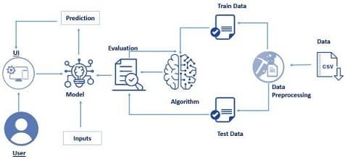
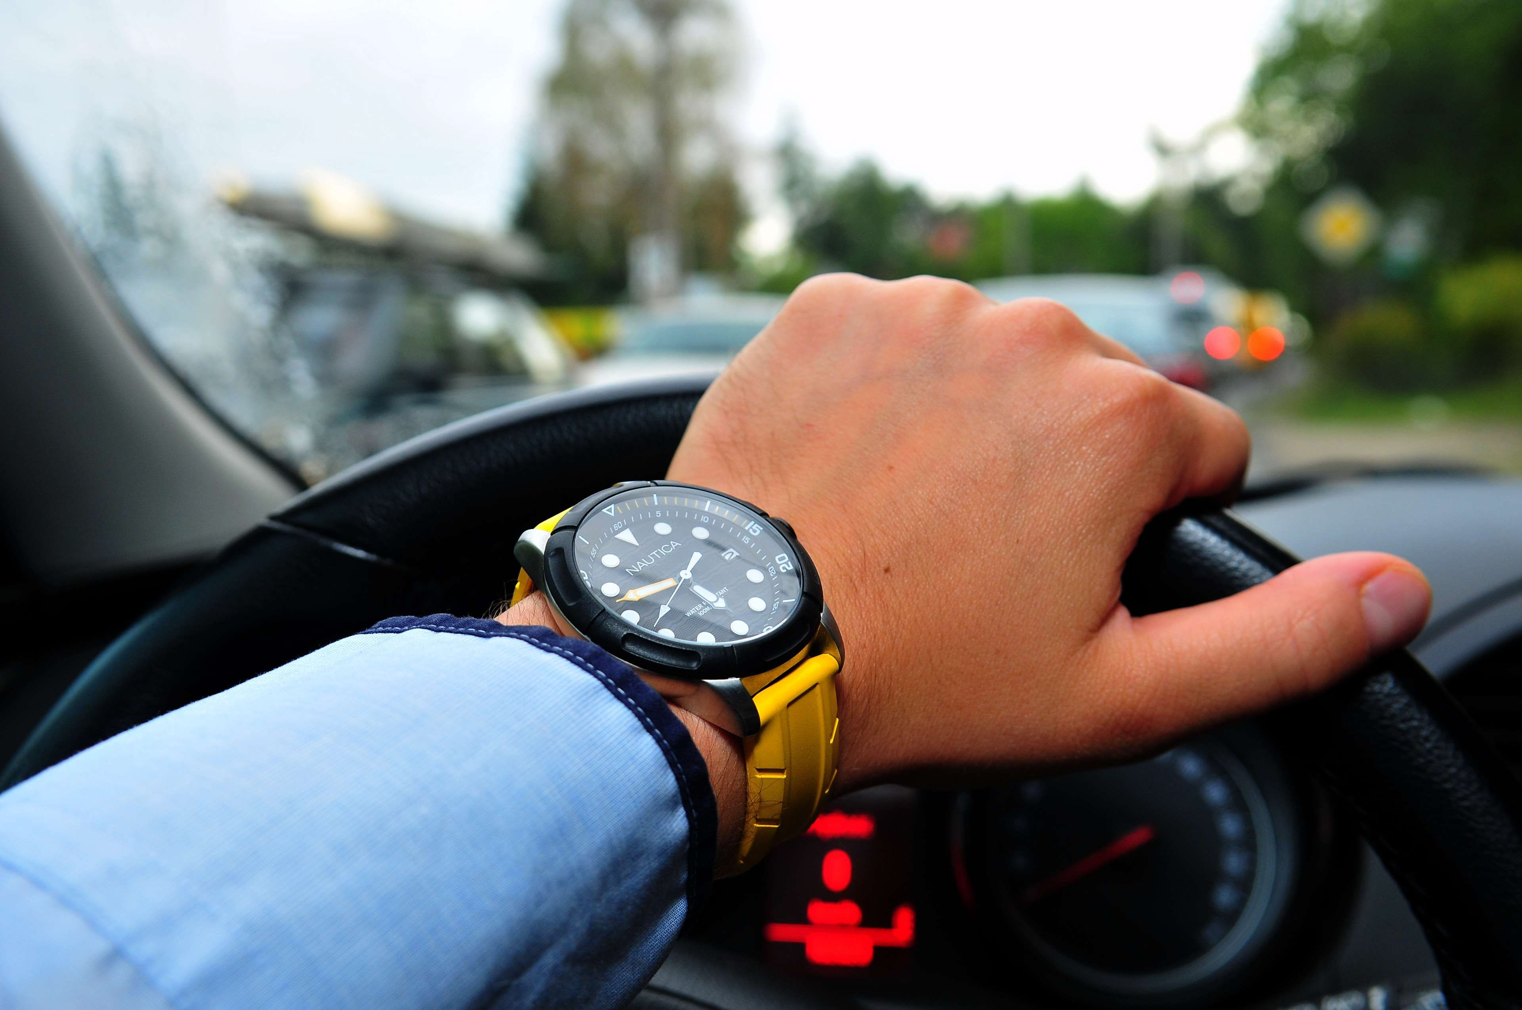
Block diagram:-

Slide 5
Procedure:-
Import the libraries and collect the dataset.
Preprocess the given data and check the null values.
Split the given data.
Train and test the splitted data using linear regression.
Build a testing model and incorporate with html and flask.
Performance can predicted.

Slide 6
Advantages:-
Performance of the car can be easily evaluated by the customer.
Linear Regression is simple to implement and easy to interprete the output of the coefficient.It gives accurate result of the prediction.
It can work in real time and predicted as soon as the necessary details for prediction are given to the model.

Slide 7
Dis-Advantages:-
One of the biggest drawback is using gasoline –powered cars in the amount of pollution into the atmosphere .
Car performance prediction can be a challenging task due to the high number of attributes that should be considered for the accurate prediction.

Slide 8
Conclusion:-
During this model, we built a model that could reliably predict a car’s mpg given some information about the car. This model could be trained with car data and be used to predict competitor’s future mpg ratings for upcoming cars.
while our model may be inaccurate in some cases, we talked about how our dataset can contain inaccurate values for the mpg, and oftentimes, our predictions are more accurate than the values in the dataset.
For cars, the collected data is significantly more reliable, so our model will be able to perform better with a different, more accurate dataset.

Slide 9
THANK YOU

